Slide 1
CSC3100 Tutorial 7
Sorting Algorithm and Tree
Yuan Xu
Wenyu Huang
CUHKSZ
Oct. 23rd, 2022
CSC3100 Tutorial 7
2022/10 / 23

Slide 2
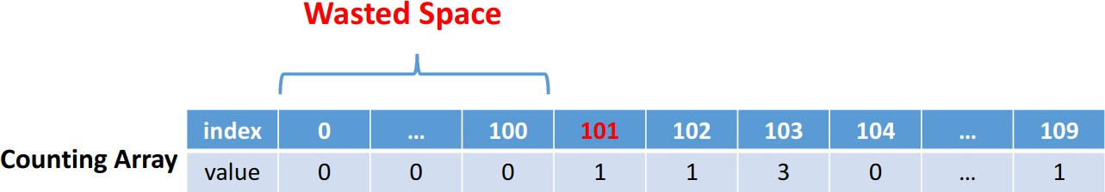
Advanced Counting Sort
Consider the following example:
101, 109, 107, 103, 108, 102, 103, 110, 107, 103
We will meet the following case:
We waste a lot of space.
CSC3100 Tutorial 7
2022/10 / 23

Slide 3
Advanced Counting Sort
Examples
101, 109, 107, 103, 108, 102, 103, 110, 107, 103
We can compress the counting array.
Actually, we can map the start index of the counting array to the minimum value of the array to be sorted.
In this example, we can map 0 to 101.
CSC3100 Tutorial 7
2022/10 / 23

Slide 4
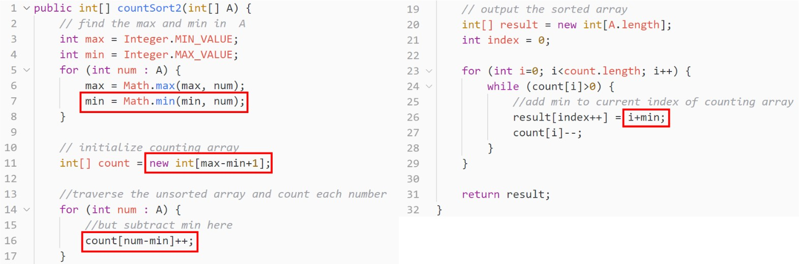
Advanced Counting Sort
CSC3100 Tutorial 7
2022/10 / 23

Slide 5
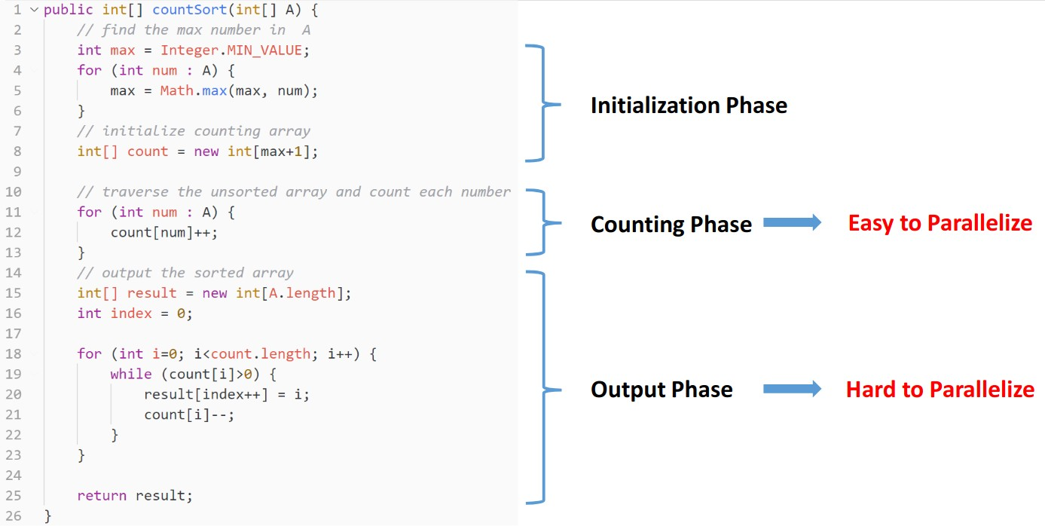
Advanced Counting Sort-Parallelization
CSC3100 Tutorial 7
2022/10 / 23

Slide 6
Advanced Counting Sort-Parallelization
How to make the Output Phase to parallelize?
Firstly, we count the prefix sum of the counting array.
So, how to calculate the prefix sum?
CSC3100 Tutorial 7
2022/10 / 23

Slide 7
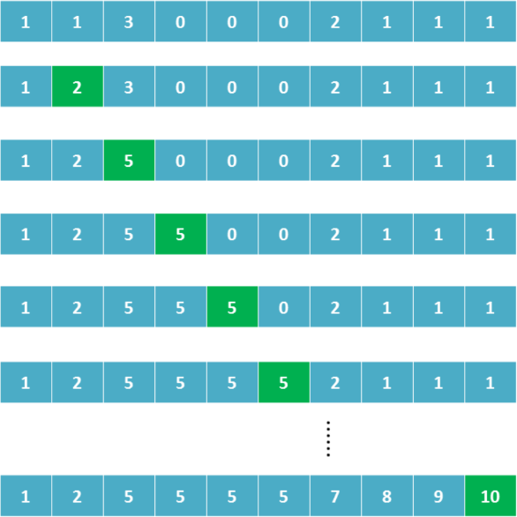
Advanced Counting Sort-Parallelization
prefix sum
CSC3100 Tutorial 7
2022/10 / 23

Slide 8
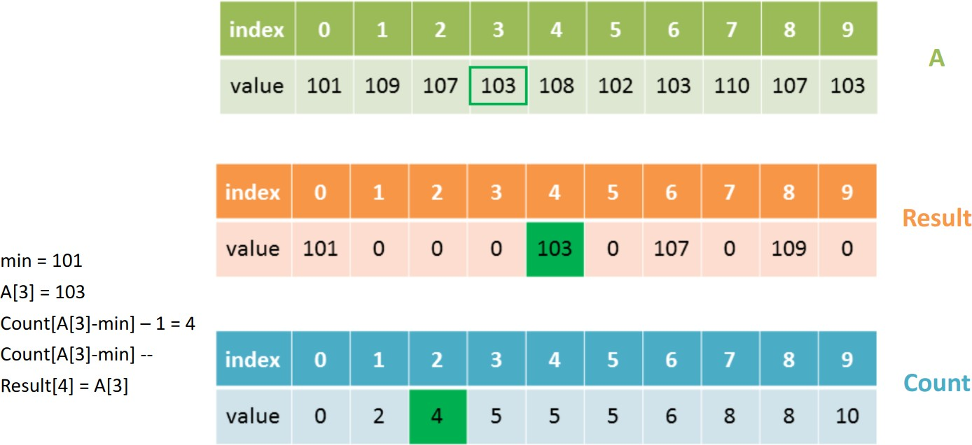
Advanced Counting Sort-Parallelization
Now, we can use the prefix sum to construct the result array.
CSC3100 Tutorial 7
2022/10 / 23

Slide 9
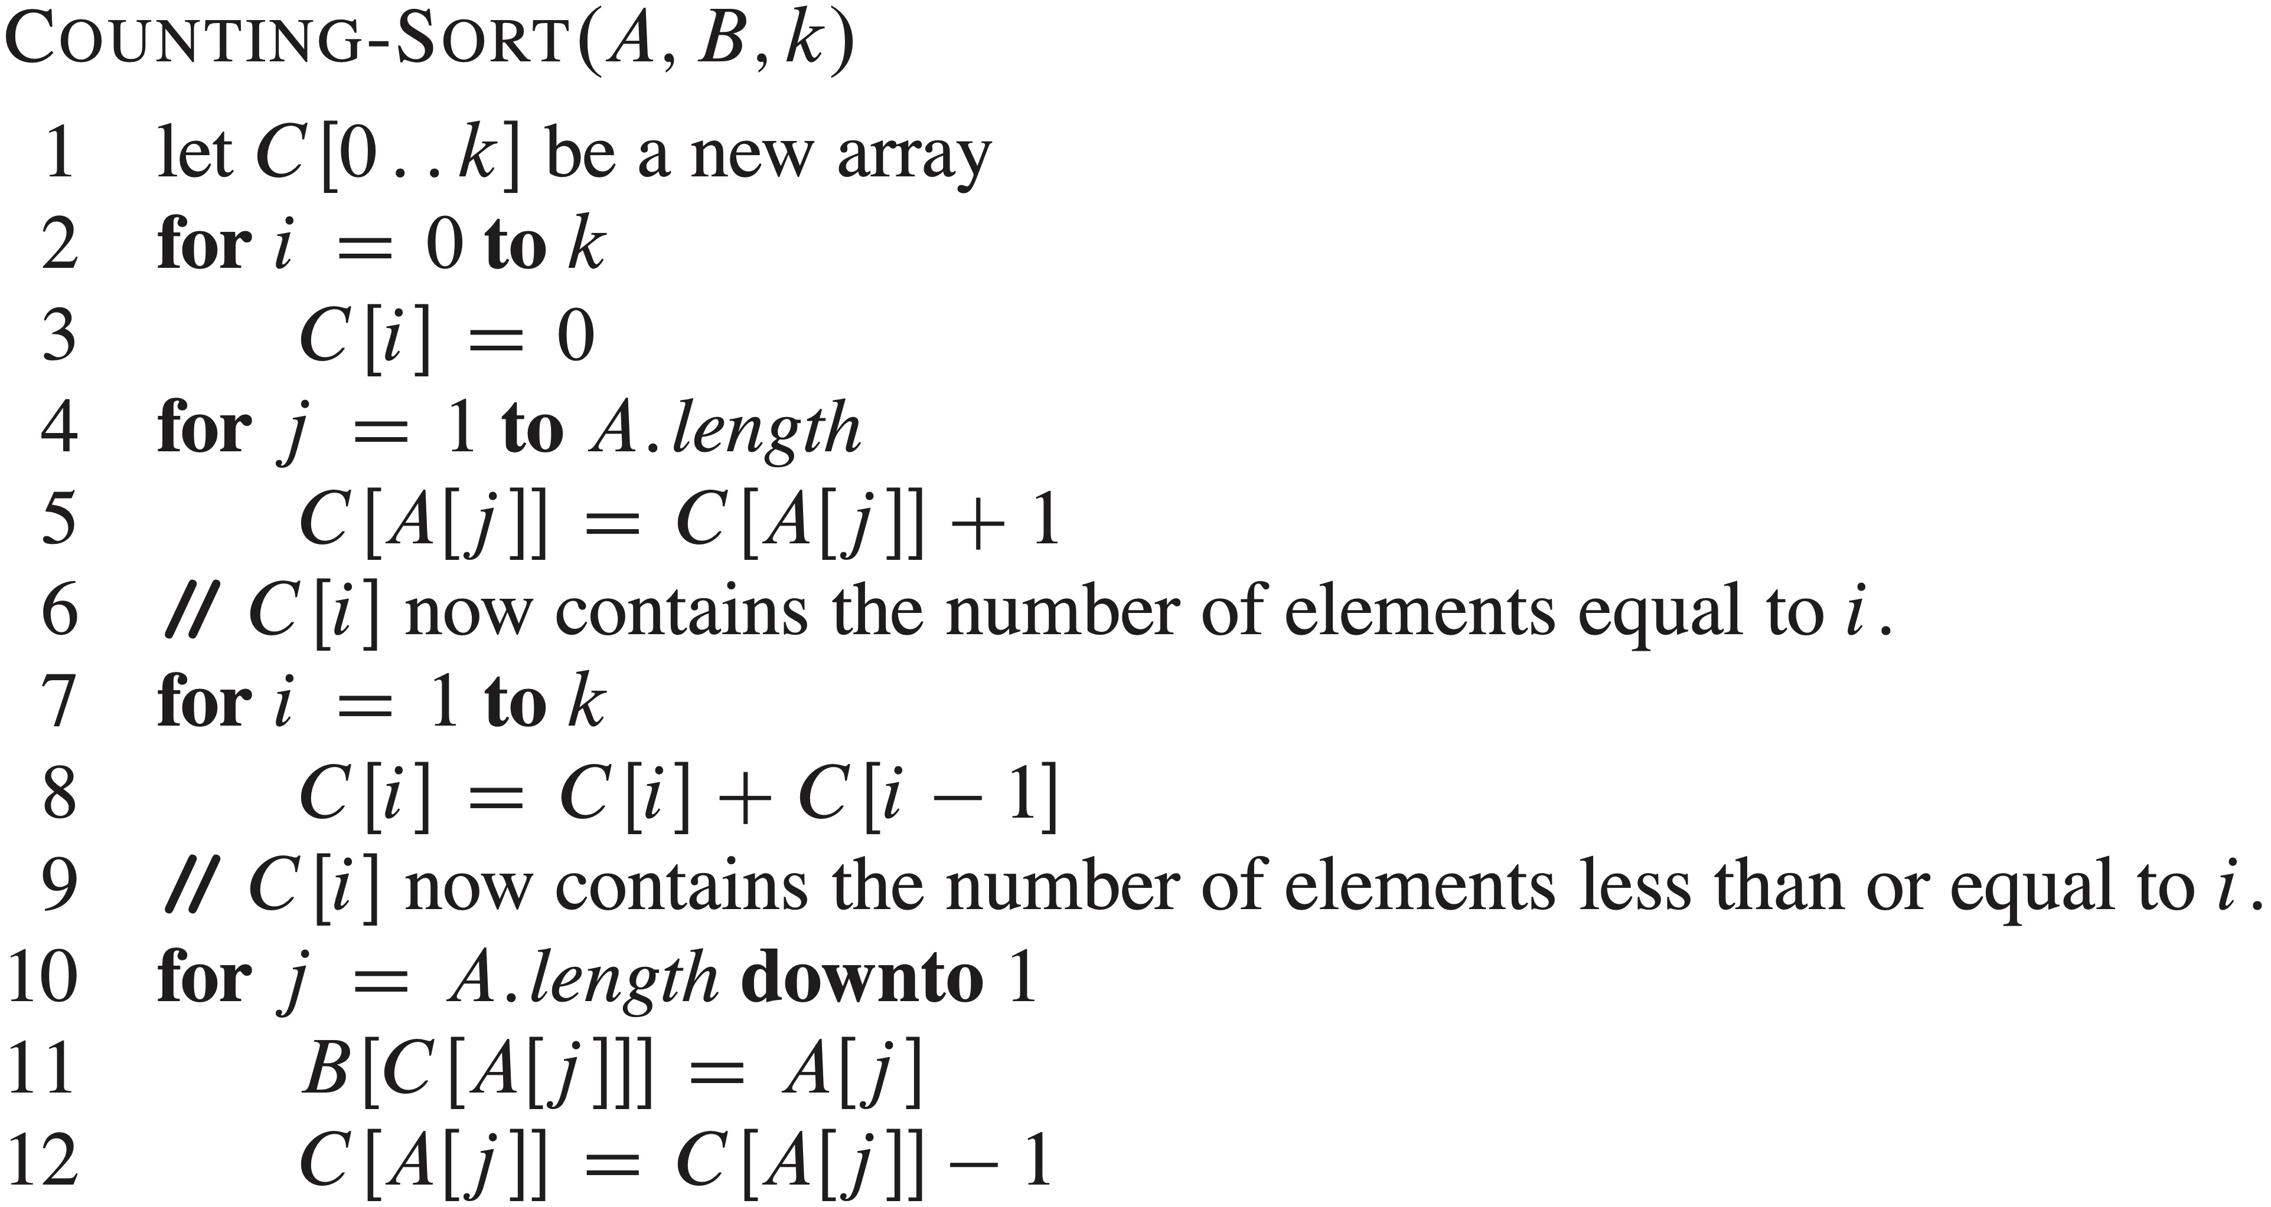
Advanced Counting Sort-Parallelization
A pseudo code to help you understand
CSC3100 Tutorial 7
2022/10 / 23

Slide 10
Kth Largest Element in an Array
Given an integer array nums and an integer k, return the kth largest element in the array.
Note that it is the kth largest element in the sorted order, not the kth distinct element.
Note
CSC3100 Tutorial 7
2022/10 / 23

Slide 11
Kth Largest Element in an Array
Here are some examples:
example 1:
intput: nums = [3,2,1,5,6,4], k = 2
output: 5
example 2:
intput: nums = [3,2,3,1,2,4,5,5,6], k = 4
output: 4
Examples
CSC3100 Tutorial 7
2022/10 / 23

Slide 12
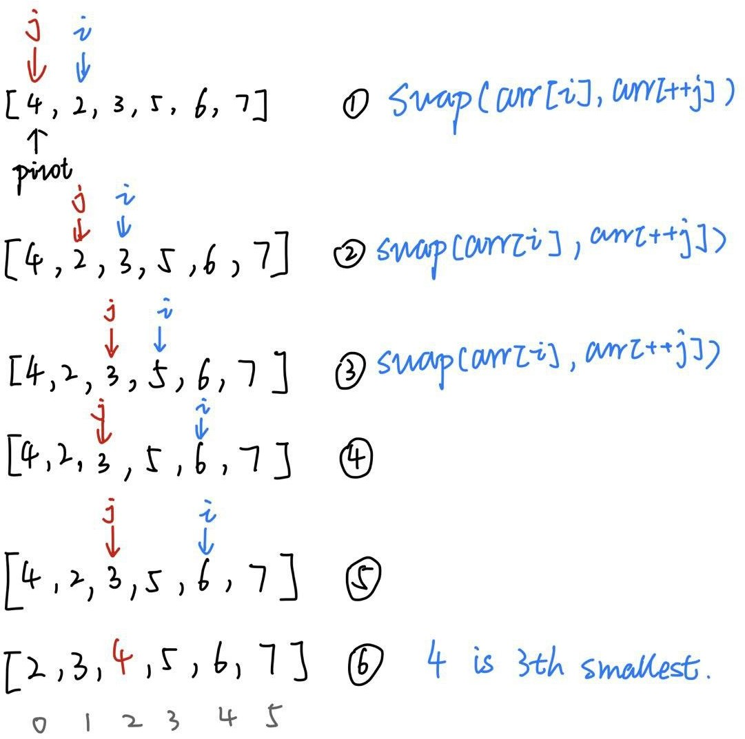
Kth Largest Element in an Array
Quick Sort Algorithm Review
CSC3100 Tutorial 7
2022/10 / 23

Slide 13
Tree & Binary Tree
Review
A tree is a finite set of one or more nodes such that
Each node stores an element
There is a specially node called the root
The remaining nodes are partitioned into n disjoint
sets T₁, ..., T_{n,} where each of these sets is a tree
We call T₁, ..., T_{n} the subtrees of the root
A binary tree is a tree
in which no node can have more than two children
CSC3100 Tutorial 7
2022/10 / 23

Slide 14
Binary Tree
strategy
Preorder (depth-first)
Visit the node
Traverse the left subtree in preorder
Traverse the right subtree in preorder
Inorder
Traverse the left subtree in inorder
Visit the node
Traverse the right subtree in inorder
Postorder
Traverse the left subtree in postorder
Traverse the right subtree in postorder
Visit the node
CSC3100 Tutorial 7
2022/10 / 23

Slide 15
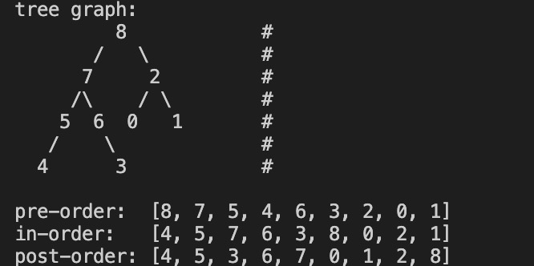
Binary Tree
Below is an example.

Slide 16
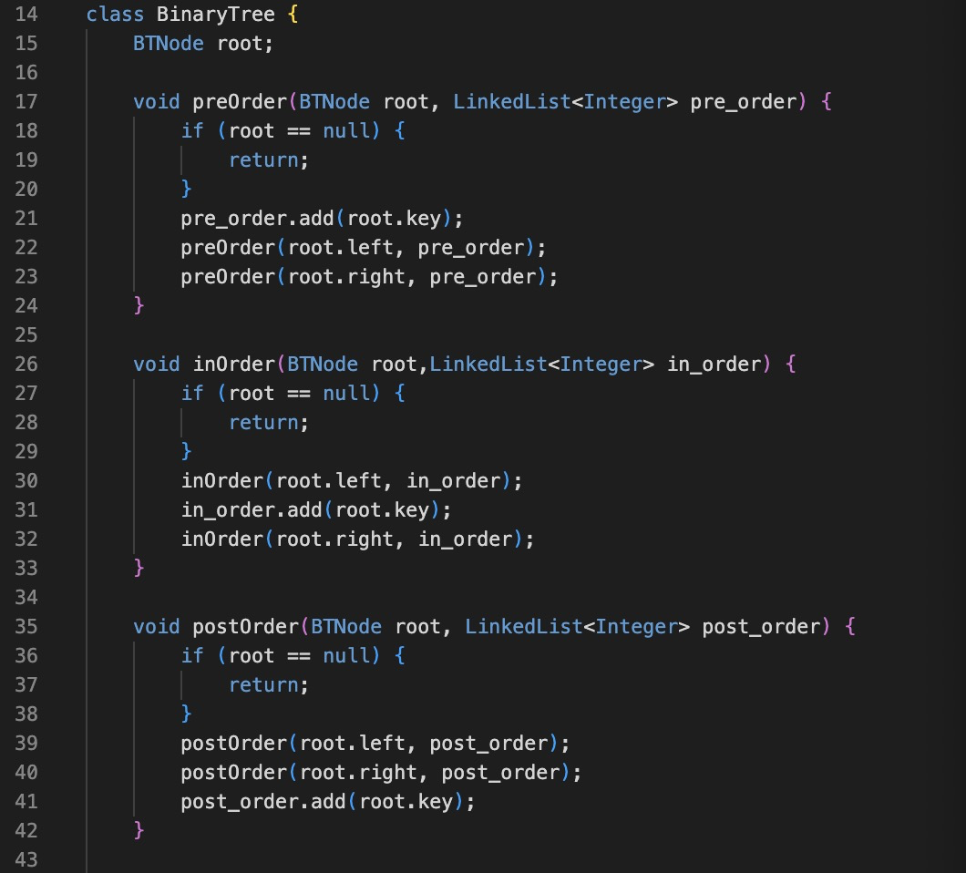
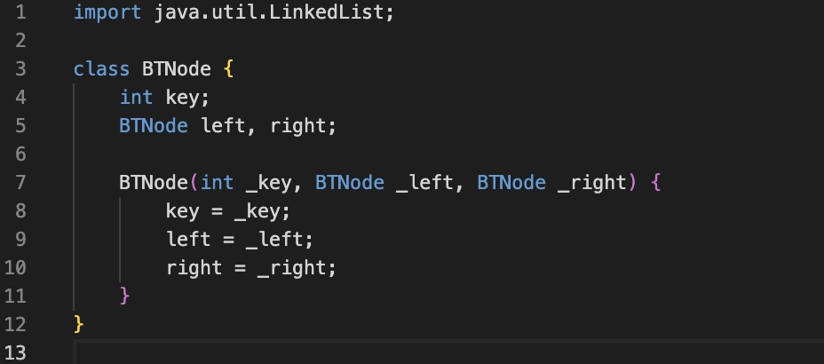
Binary Tree
How to traverse a tree using recursion
java version

Slide 17
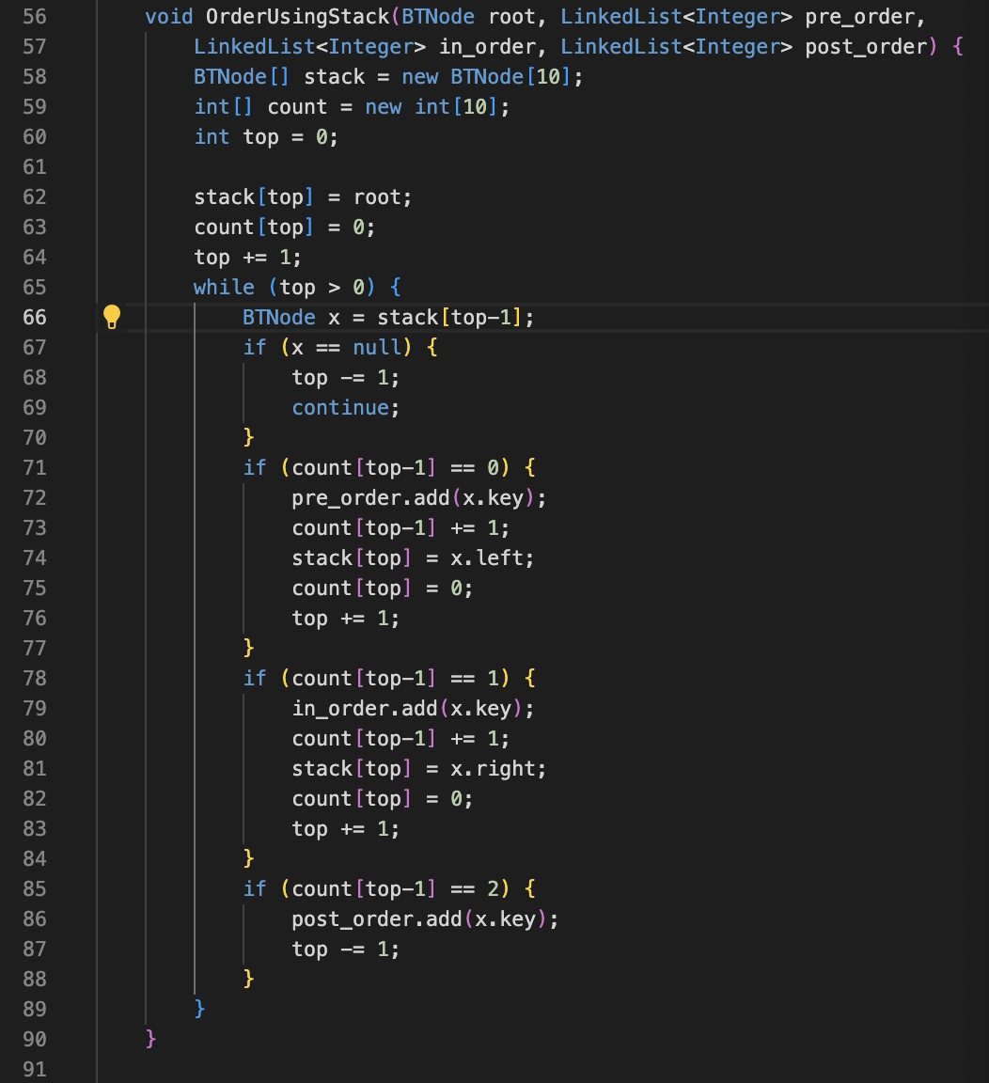
Binary Tree
How to traverse a tree using stack
java version

Slide 18
Binary Tree
How to traverse a tree using recursion
C++ Version
1 | void pre Order Recur ( Tree Node * root , vector <int>& result ) {
2 | result . push_ back ( root -> val );
3 | if( root -> left == nullptr && root -> right == nullptr ) |  | {
4 |  | return;
5 |  | }
6 |  | if( root -> left != nullptr ) {
7 |  | pre Order Recur ( root -> left , result );
8 |  | }
9 |  | if( root -> right != nullptr ) {
10 |  | pre Order Recur ( root -> right , result );
11 |  | }
12 | }
CSC3100 Tutorial 7
2022/10 / 23

Slide 19
Binary Tree
How to traverse a tree using recursion
C++ Version
1 void in Order Recur ( Tree Node * root , vector <int>& result ) {
2 |  | if( root -> left != nullptr ) {
3 |  | in Order Recur ( root -> left , result );
4 |  | }
5 |  | result . push_ back ( root -> val );
6 |  | if( root -> right != nullptr ) {
7 |  | in Order Recur ( root -> right , result );
8 |  | }
9 | }
CSC3100 Tutorial 7
2022/10 / 23

Slide 20
Binary Tree
How to traverse a tree using recursion
C++ Version
void post Order Recur ( Tree Node * root , vector <int>&
if( root -> left != nullptr ) {
post Order Recur ( root -> left , result );
result ) {
4 |  | }
5 |  | if( root -> right != nullptr ) {
6 |  | post Order Recur ( root -> right , result );
7 |  | }
8 |  | result . push_ back ( root -> val );
9 | }
CSC3100 Tutorial 7
2022/10 / 23

Slide 21
Binary Tree
How to traverse a tree using stack
C++ Version
void post Order Stack ( Tree Node * root , vector <int>&
stack < Tree Node *> s;
auto current = root ;
auto last Visited = root ;
while (! s. empty () || current ) {
while( current ) {
s. push ( current );
current = current -> left ;
9 }
10 current = s. top ();
11
result ) {
if (! current -> right || current -> right == lastVisited ) {
s. pop ();
result . push_ back ( current -> val ); lastVisited = current ;
current = nullptr ;
12
13
14
15
CSC3100 Tutorial 7
2022/10 / 23

Slide 22
Binary Tree
How to traverse a tree using stack
C++ Version
16 |  |  | }else{
17 |  |  | current = current -> right ;
18 |  |  | }
19 |  | }
20 | }
CSC3100 Tutorial 7
2022/10 / 23

Slide 23
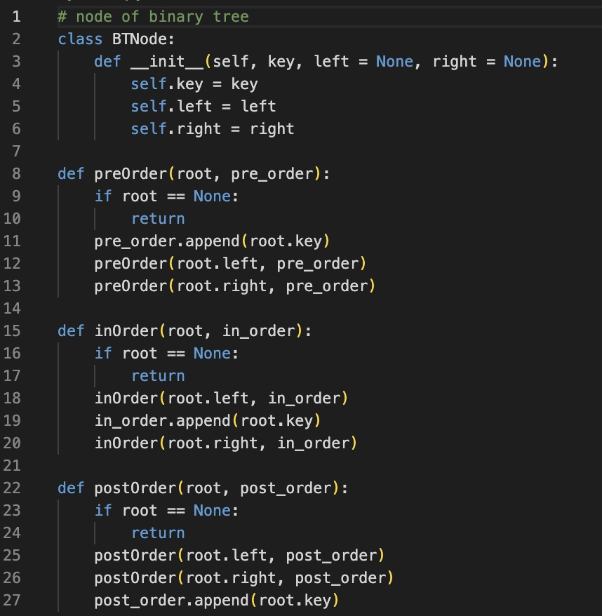
Binary Tree
How to traverse a tree using recursion
python version

Slide 24
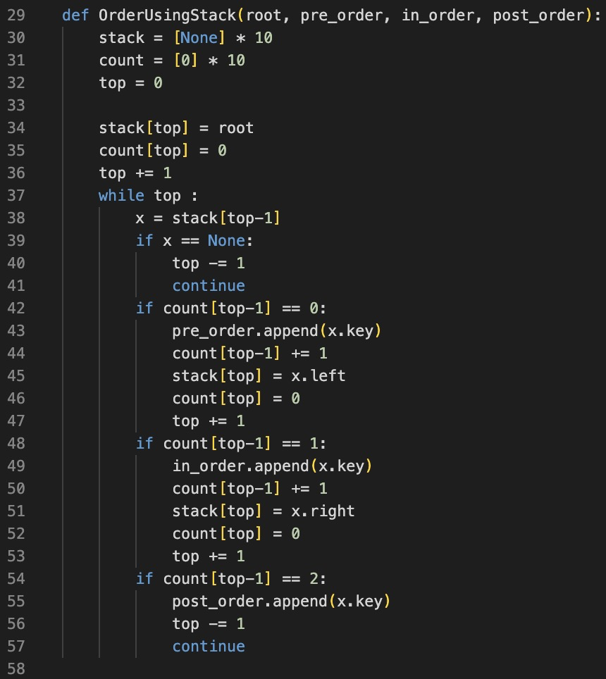
Binary Tree
How to traverse a tree using stack
python version

Slide 25
Exercise
Implement Parallelized Count Sorting
Implement preorder and inorder traversal using stack
CSC3100 Tutorial 7
2022/10 / 23

Slide 26
Exercise
Sort Colors
Given an array nums with n objects colored red, white, or blue, sort them in-place so that objects of the same color are adjacent, with the colors in the order red, white, and blue.
We will use the integers 0, 1, and 2 to represent the color red, white, and blue, respectively.
You must solve this problem without using the library’s sort function.
CSC3100 Tutorial 7
2022/10 / 23

Slide 27
Exercise
Sort Colors
Here are some examples:
example 1:
intput: nums = [2,0,2,1,1,0]
output: [0,0,1,1,2,2]
example 2:
intput: nums = [2,0,1]
output: [0,1,2]
Examples
CSC3100 Tutorial 7
2022/10 / 23

Slide 28
Thank you Q&A
CSC3100 Tutorial 7
2022/10 / 23

